Slide 1
Computer Organization and Assembly Language
Week 1 to 3
Dr. Muhammad Nouman Durrani

Slide 2
Introduction
Definition 1:
Computer organization is concerned with the way hardware components operate and the way they are connected together to form a computer system.
Definition 2:
Computer organization is concerned with the structure and behavior of a computer system.
Definition 3:
Assembly language consists of statements written with short mnemonics such as ADD, MOV, SUB, and CALL.

Slide 3
Introduction
The main objective of this course is to:
Understand the basic structure of a computer system
How to write programs by understanding the hardware structure

Slide 4
Assembly Language Programming
An assembly language is a low-level programming language designed for a specific type of processor
Assembly language is used to write the program using alphanumeric symbols (or mnemonic), e.g. ADD, MOV, PUSH etc.
Assembly Language depends on the machine code instructions
Every assembler has its own assembly language
Assembly language has a one-to-one relationship with machine language:
Each assembly language instruction corresponds to a single machine-language instruction.
A single machine-language instruction can take up one or more bytes of code

Slide 5
Assembly language programming
The instruction must specify which operation (opcode) is to be performed and the operands
E.g. ADD AX, BX
ADD is the operation
AX is called the destination operand
BX is called the source operand
The result is AX = AX + BX
When writing assembly language program, you need to think in the instruction level

Slide 6

Assembly language programming: Example
MOV AL, 00H
The native language of a computer is machine language (using 0,1 to represent the operation)
The machine language code for the above instruction is B4 00 (2 bytes)
After assembled, and linked into an executable program, the value B400 will be stored in the memory
When the program is executed, then the value B400 is read from memory, decoded and carry out the task
The executable program could be .com, .exe, or .bin files

Slide 7
Assembly language programming
Learning assembly language programming will help understanding the operations of a microprocessor
To learn:
Need to know the functions of various registers
Need to know how external memory is organized and how it is addressed to obtain instructions and data (different addressing modes)
Need to know what operations (or the instruction set) are supported by the CPU

Slide 8
High Level Languages
A high-level language (HLL) is a programming language that enables a programmer to write programs that are more or less independent of a particular type of computer
Such languages are considered high-level because they are closer to human languages and further from machine languages.
Examples are C, C++, Java, FORTRAN, or Pascal

Slide 9
High Level Languages
High-level languages such as C++ and Java have a one-to-many relationship with assembly language and machine language.
A single statement in C++ expands into multiple assembly language or machine instructions.
The following C++ code carries out two arithmetic operations and assigns the result to a variable. Assume X and Y are integers:
int Y;
int X = (Y + 4) * 3;

Slide 10
Example: int Y; int X = (Y + 4) * 3;
Following is the equivalent translation to assembly language.
The translation requires multiple statements because assembly language works at a detailed level:
mov eax,Y ; move Y to the EAX register
add eax,4 ; add 4 to the EAX register
mov ebx,3 ; move 3 to the EBX register
imul ebx ; multiply EAX by EBX
mov X,eax ; move EAX to X
Registers are named storage locations in the CPU that hold intermediate results of operations

Slide 11
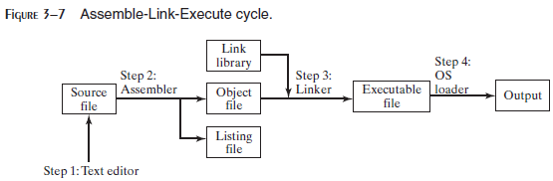
What Are Assemblers and Linkers?
Assembler is a utility program that converts source code programs from assembly language into an object file, a machine language translation of the program.
Optionally a Listing file is also produced.
We’ll use MASM as our assembler.
The linker reads the object file and checks to see if the program contains any calls to procedures in a link library.
The linker copies any required procedures from the link library, combines them with the object file, and produces the executable file.
Microsoft 16-bit linker is LINK.EXE and 32-bit is Linker LINK32.EXE.
OS Loader: A program that loads executable files into memory, and branches the CPU to the program’s starting address, (may initialize some registers (e.g. IP) ) and the program begins to execute.
Debugger is a utility program, that lets you step through a program while it’s running and examine registers and memory
MASM provides CodeView, TASM provides Turbo Debugger and msdev.exe for 32-bit Window console programs.

Slide 12
Listing File
A listing file contains:
a copy of the program’s source code,
with line numbers,
the numeric address of each instruction,
the machine code bytes of each instruction (in hexadecimal), and
a symbol table.
The symbol table contains the names of all program identifiers, segments, and related information.

Slide 13
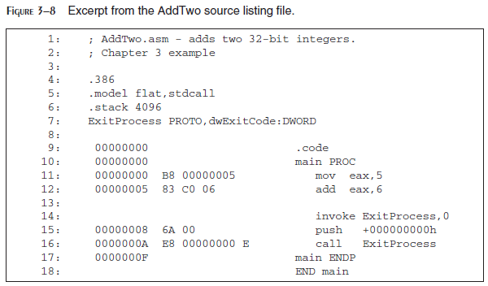

Slide 14
Assembly Language for x86 Processors
Assembly Language for x86 Processors focuses on programming microprocessors compatible with the Intel IA-32 and AMD x86 processors running under Microsoft Windows.
Assembly language bears the closest resemblance to native machine language.

Slide 15
Is Assembly Language Portable?
A language whose source programs can be compiled and run on a wide variety of computer systems is said to be portable.
A C++ program, for example, should compile and run on just about any computer, unless it makes specific references to library functions that exist under a single operating system.
A major feature of the Java language is that compiled programs run on nearly any computer system.

Slide 16
Is Assembly Language Portable?
Assembly language is not portable because it is designed for a specific processor family.
There are a number of different assembly languages widely used today, each based on a processor family.
Some well-known processor families are Motorola 68x00, x86, SUN Sparc, Vax, and IBM-370.
The instructions in assembly language may directly match the computer’s architecture or they may be translated during execution by a program inside the processor known as a microcode interpreter.

Slide 17
What you’ll learn from Assembly Language Programming
You will learn:
Some basic principles of computer architecture, as applied to the Intel IA-32 processor family.
How IA-32 processors manage memory, using real mode, protected mode, and virtual mode.
How high-level language compilers (such as C++) translate statements from their language into assembly language and native machine code.
How high-level languages implement arithmetic expressions, loops, and logical structures at the machine level.

Slide 18
What you’ll learn from Assembly Language Programming
You will improve your machine-level debugging skills.
Even in C++, when your programs have errors due to pointers or memory allocation, you can dive to the machine level and find out what really went wrong.
High-level languages purposely hide machine-specific details, but sometimes these details are important when tracking down errors.
Assembly language will help you understanding the interaction between the computer hardware, operating system, and application programs.

Slide 19
Applications of Assembly Language
Embedded systems programs are written in C, Java, or assembly language, and downloaded into computer chips and installed in dedicated devices.
Some examples are automobile fuel and ignition systems, air-conditioning control systems, security systems, flight control systems, hand-held computers, modems, printers, and other intelligent computer peripherals.
Many dedicated computer game machines have stringent memory restrictions, requiring programs to be highly optimized for both space and runtime speed.
Game programmers use assembly language to take full advantage of specific hardware features in a target system.

Slide 20
Virtual Machine Concept
Virtual Machine Concept:
An effective way to explain how a computer’s hardware and software are related is called the virtual machine concept.
Specific Machine Levels

Slide 21
Virtual Machines
Virtual machine is a software program that emulates the functions of some other physical or virtual computer.
Programming Language analogy:
Each computer has a native machine language (language L0) that runs directly on its hardware
A more human-friendly language is usually constructed above machine language, called Language L1
The virtual machine VM1, can execute commands written in language L1.
The virtual machine VM0 can execute commands written in language L0

Slide 22
Virtual Machines (Continue…)
Programs written in L1 can run in two different ways:
Translation – L1 program is completely translated into an L0 program (which then runs on the computer hardware)
Interpretation – L0 program interprets and executes L1 instructions one by one

Slide 23
Translating Languages
English: Display the sum of A times B plus C.
C++: cout << (A * B + C);
Assembly Language:
mov eax,A
mul B
add eax,C
call WriteInt
Intel Machine Language:
A1 00000000
F7 25 00000004
03 05 00000008
E8 00500000

Slide 24
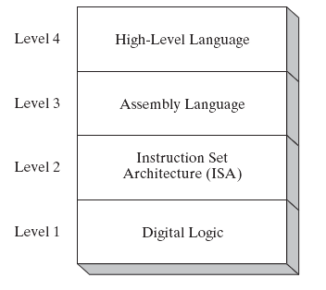
Specific Machine Levels
(descriptions of individual levels follow . . . )

Slide 25
High-Level Language
Level 4
Application-oriented languages
C++, Java, Pascal, Visual Basic . . .
Programs compile into assembly language (Level 3)

Slide 26
High-Level Language
The Java programming language is based on the virtual machine concept.
A program written in the Java language is translated by a Java compiler into Java byte code - a low-level language code.
Java byte code is executed at runtime by a program known as a Java virtual machine (JVM).

Slide 27
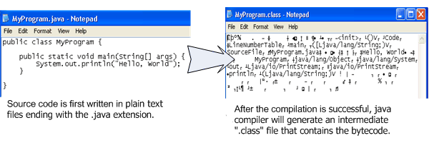
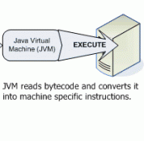
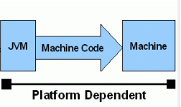
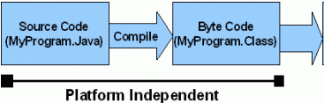
Interpret
Java code / Bytecode is always the same on different OS.
That makes java program as platform independent.
JVM is platform dependent that means there are different implementation of JVM on different OS.

Slide 28
Assembly Language
Level 3
Instruction mnemonics that have a one-to-one correspondence to machine language
Programs are translated into Instruction Set Architecture Level - machine language (Level 2)
The instructions in assembly language may directly match the computer’s architecture or they may be translated during execution by a program inside the processor known as a microcode interpreter.

Slide 29
Instruction Set Architecture (ISA)
Level 2
Also known as conventional machine language
Executed by Level 1 (Digital Logic)

Slide 30
Digital Logic
Level 1
CPU, constructed from digital logic gates
System bus
Memory
Implemented using bipolar transistors

Slide 31
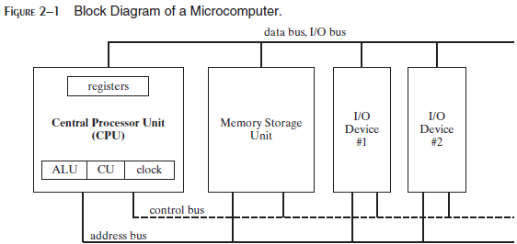
Basic Microcomputer Design

Slide 32
The central processor unit (CPU): Where calculations and logic operations are performed:
contains a limited number of storage locations named registers,
a high-frequency clock,
a control unit, and
an arithmetic logic unit
The memory storage unit is where instructions and data are held while a computer program is running.

Slide 34
The storage unit receives requests for data from the CPU, transfers data from random access memory (RAM) to the CPU, and transfers data from the CPU into memory.
All processing of data takes place within the CPU, so programs residing in memory must be copied into the CPU before they can execute.

Slide 35
BUSES
A bus is a group of parallel wires that transfer data from one part of the computer to another.
A computer system usually contains four bus types: data, I/O, control, and address.
The data bus transfers instructions and data between the CPU and memory.
The I/O bus transfers data between the CPU and the system input/output devices.
The control bus uses binary signals to synchronize actions of all devices attached to the system bus.
The address bus holds the addresses of instructions and data when the currently executing instruction transfers data between the CPU and memory.

Slide 36
Clock and Clock Cycles
Clock synchronizes all CPU and BUS operations
Clock is used to trigger events
Clock cycles measure time of a single operation
A machine instruction requires at least one clock cycle to execute
Few require in excess of 50 clocks (the multiply instruction on the 8088 processor, for example)
Instructions requiring memory access often have empty clock cycles called wait states
Because of the differences in the speeds of the CPU, the system bus, and memory circuits
Notes:
The clock rate or clock speed typically refers to the frequency at which the clock generator of a processor can generate pulses, which are used to synchronize the operations of its components, and is used as an indicator of the processor's speed.

Slide 37
Instruction Execution Cycle
The CPU go through a predefined sequence of steps to execute a machine instruction, called the instruction execution cycle.
The instruction pointer (IP) register holds the address of the instruction we want to execute.

Slide 38
Instruction Execution Cycle
Here are the steps to execute it:
First, the CPU fetch the instruction from the instruction queue
It then increments the instruction pointer
2. Next, the CPU decodes the instruction by looking at its binary bit pattern
This bit pattern might reveal that the instruction has operands (input values)
3. If operands are involved, the CPU fetches the operands from registers and memory
Sometimes, this involves address calculations
4. Next, the CPU executes the instruction, using any operand values it fetched during the earlier step
It also updates a few status flags, such as Zero, Carry, and Overflow
5. Finally, if an output operand was part of the instruction, the CPU stores the result of its execution in the operand

Slide 39
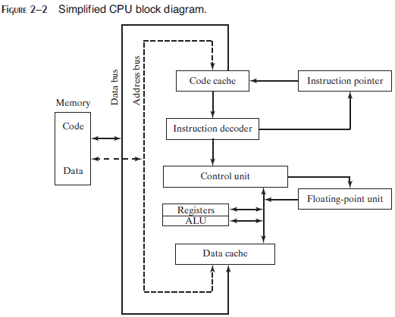
Instruction Execution Cycle
An operand is a value that is either an input or an output to an operation
For example, the expression Z = X + Y has two input operands (X and Y) and a single output operand (Z)
In order to read program instructions from memory, an address is placed on the address bus
The memory controller places the requested code on the data bus
Making the code available inside the code cache

Slide 40
Instruction Execution Cycle
The instruction pointer’s value determines which instruction will be executed next.
The instruction is analyzed by the instruction decoder
Causing appropriate digital signals to be sent to the Control Unit
Control Unit coordinates with the ALU and floating-point unit.
Control bus carries signals that use the system clock to coordinate the transfer of data between different CPU components.

Slide 41
Reading from Memory
As a rule, computers read memory much more slowly than they access internal registers.
Reading a single value from memory involves four separate steps:
Place the address of the value you want to read on the address bus.
Assert (change the value of) the processor’s RD (read) pin.
Wait one clock cycle for the memory chips to respond.
Copy the data from the data bus into the destination operand.
Each of these steps generally requires a single clock cycle,

Slide 42
Cache (1 of 2)
CPU designers figured out that computer memory creates a speed bottleneck
because most programs have to access variables
To reduce the amount of time spent in reading and writing memory
the most recently used instructions and data are stored in high-speed memory called cache
The idea is that a program is more likely want to access the same memory and instructions repeatedly
so cache keeps these values where they can be accessed quickly

Slide 43
Cache (2 of 2)
When the CPU begins to execute a program, it loads the next thousand instructions (for example) into cache
The assumption is that these instructions will be needed in the near future.
If it happens to be a loop in that block of code, the same instructions will be in cache
When the processor is able to find its data in cache memory, we call that a cache hit
On the other hand, if the CPU tries to find something in cache and it’s not there, we call that a cache miss

Slide 44
x86 family Cache types
Cache memory for the x86 family comes in two types.
Level-1 cache (or primary cache) is stored right on the CPU.
Level-2 cache (or secondary cache) is a little bit slower, and attached to the CPU by a high-speed data bus.

Slide 45
Why cache memory is faster than conventional RAM?
It’s because cache memory is constructed from a special type of memory chip called static RAM
It’s expensive, but it does not have to be constantly refreshed in order to keep its contents
Conventional memory, known as dynamic RAM, refreshed constantly
It’s much slower, and cheaper

Slide 46
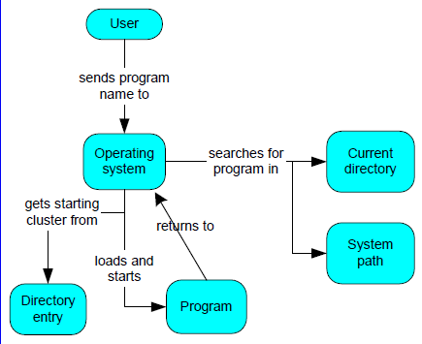
Loading and Executing a Program (1 of 3)
The operating system (OS) searches for the program’s filename in the current disk directory
If it cannot find the name there, it searches a predetermined list of directories (called paths) for the filename
If the OS fails to find the program filename, it issues an error message

Slide 47
Loading and Executing a Program (2 of 3)
If the program file is found, the OS retrieves basic information about the program’s file from the disk directory
including the file size and
its physical location on the disk drive.
The OS determines the next available location in memory and loads the program file into memory
It allocates a block of memory to the program and enters information about the program’s size and location into a table (sometimes called a descriptor table).
The OS also adjust the values of pointers within the program so they contain addresses of program data.

Slide 48
Loading and Executing a Program (3 of 3)
The OS begins execution of the program’s first machine instruction (its entry point).
As soon as the program begins running, it is called a process.
The OS assigns the process an identification number (process ID), which is used to keep track of it while running.
It is the OS’s job to track the execution of the process and to respond to requests for system resources.
Examples of resources are memory, disk files, and input-output devices.
When the process ends, it is removed from memory.

Slide 49
How a Program Runs

Slide 50
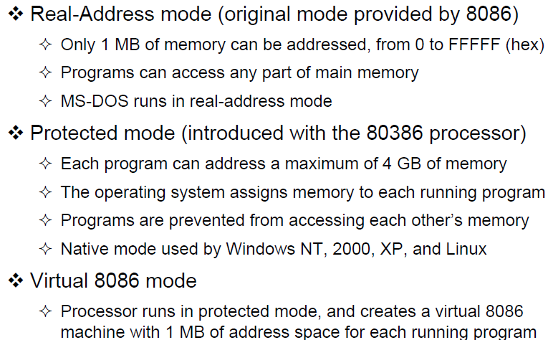
Mode of Operations
x86 processors have three primary modes of operation: protected mode, real-address mode, and system management mode.
Implements the programming environment of the Intel 8086 processor
This mode is available in Windows 98, and can be used to run an MS-DOS program that requires direct access to system memory and hardware devices
Programs running in real-address mode can cause the operating system to crash (stop responding to commands)
Slide Credit: Dr. Aiman El-Maleh & Dr. Kip Irvine

Slide 51
Mode of Operations
(segments)
Slide Credit: Dr. Aiman El-Maleh & Dr. Kip Irvine

Slide 52
Mode of Operations
Virtual 8086 mode: A sub-mode, virtual-8086, is a special case of protected mode
such as MS-DOS
If an MS-DOS program crashes or attempts to write data into the system memory area, it will not affect other programs running at the same time
Windows XP can execute multiple separate virtual-8086 sessions at the same time
Slide Credit: Dr. Aiman El-Maleh & Dr. Kip Irvine

Slide 53
Mode of Operations
System Management Mode:
Provides a mechanism for implementation power management and system security
Manage system safety functions, such as shutdown on high CPU temperature and turning the fans on and off
Handle system events like memory or chipset errors

Slide 54
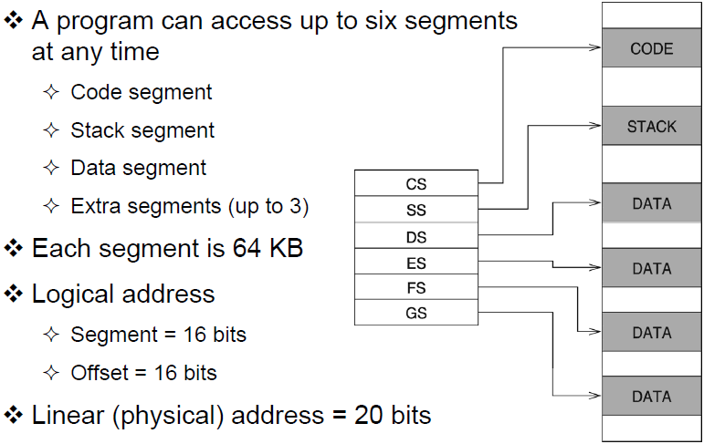
Real Address Mode (1)
Slide Credit: Dr. Aiman El-Maleh & Dr. Kip Irvine

Slide 55
Real Address Mode
Program Segments and Segment Registers: Segment registers are used to hold base addresses for the program code, data and stack.
The code segment holds the base address for all executable instructions in the program
The data segment holds the base address for variables. This segment stores data for the program
The extra segment is an extra data segment (often used for shared data)
The stack segment holds the base address for the stack. The segment is also to store interrupt and subroutine return addresses

Slide 56
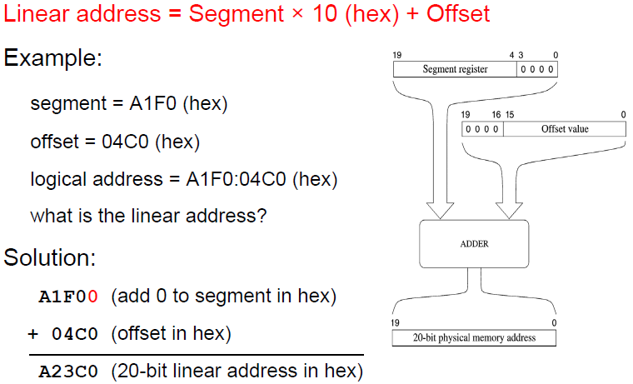
Real Address Mode (2)
Slide Credit: Dr. Aiman El-Maleh & Dr. Kip Irvine

Slide 57
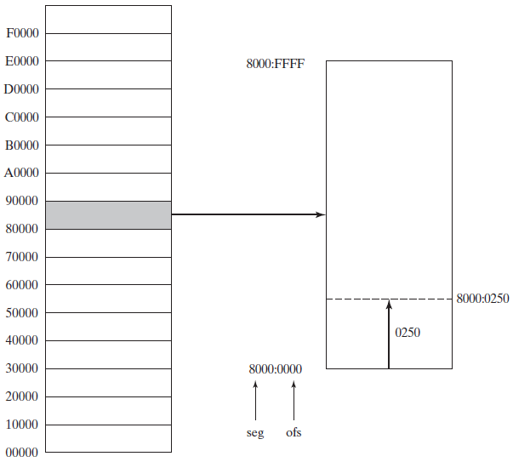
Real Address Mode (3)

Slide 58
Address Space
In 32-bit protected mode, a task or program can address a linear address space of up to 4 GBytes
Extended Physical Addressing allows a total of 64 GBytes of physical memory to be addressed
Real-address mode programs, on the other hand, can only address a range of 1 MByte
If the processor is in protected mode and running multiple programs in virtual-8086 mode, each program has its own 1-MByte memory area

Slide 59
Basic Program Execution Registers
Registers are high-speed storage locations directly inside the CPU, designed to be accessed at much higher speed than conventional memory
There are eight general-purpose registers, six segment registers, a processor status flags register (EFLAGS), and an instruction pointer (EIP)

Slide 60
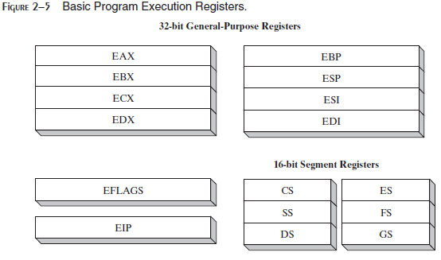

Slide 61
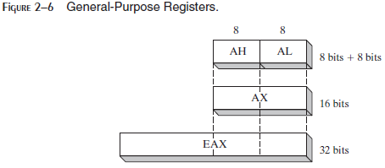
General-Purpose Registers:
The general-purpose registers are primarily used for arithmetic and data movement.
As shown in Figure 2–6, the lower 16 bits of the EAX register can be referenced by the name AX
Portions of some registers can be addressed as 8-bit values
For example, the AX register, has an 8-bit upper half named AH and an 8-bit lower half named AL

Slide 62
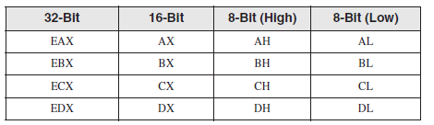
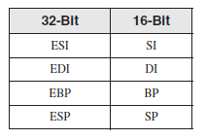
The remaining general-purpose registers can only be accessed using 32-bit or 16-bit names, as shown in the following table:

Slide 63
Specialized Uses of general-purpose registers
Some general-purpose registers have specialized uses:
• EAX (accumulator) - favored for arithmetic operations.
It is automatically used by multiplication and division instructions
EBX (Base) - Holds base address for procedures and variables
ECX - The CPU automatically uses ECX as a counter for looping operations
EDX (Data) - Used in multiplication and division operations

Slide 64
Index Registers
Index Registers contain the offsets for data and instructions.
Offset- distance (in bytes) from the base address of the segment.
• ESP (extended stack pointer register) contains the offset for the top of the stack to addresses data on the stack (a system memory structure)
• ESI and EDI (extended source index and extended destination index ) points to the source and destination string respectively in the string move instructions
• EBP is used to reference function parameters and local variables on the stack

Slide 65
Segment Registers:
In real-address mode, 16-bit segment registers indicate base addresses of pre-assigned memory areas named segments.
In protected mode, segment registers hold pointers to segment descriptor tables (The descriptor describes the location, length and access rights of the memory segment).
Some segments hold program instructions (code), others hold variables (data), and another segment named the stack segment holds local function variables and function parameters.
Instruction Pointer :
The EIP, or instruction pointer, register contains the address of the next instruction to be executed.
Certain machine instructions manipulate EIP, causing the program to branch to a new location.

Slide 66
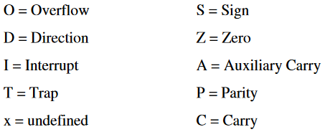
EFLAGS Register:
The EFLAGS register consists of individual binary bits that control the operation of the CPU or reflect the outcome of some CPU operation.
A flag is set when it equals 1; it is clear (or reset) when it equals 0.
Programs can set individual bits in the EFLAGS register to control the CPU’s operation
For example: Interrupt when arithmetic overflow is detected

Slide 67
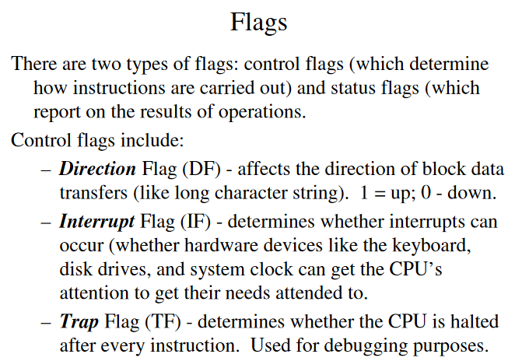

Slide 68
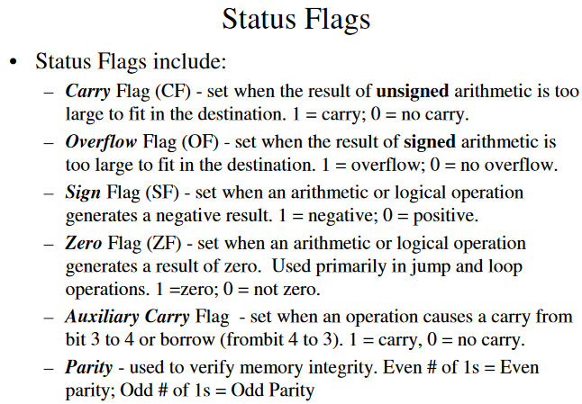
The Status flags reflect the outcomes of arithmetic and logical operations performed by the CPU.
Parity- is set if the least-significant byte in the result contains an even number of 1 bits. It used to verify memory integrity.

